Slide 1



CATCH THE AI
AI GENERATED MEDIA DETECTION

Slide 2
Project Team
Romani Nasrat Shawqi .
Ahmed Mohamed Ali.
Zeyad Elsayed Abdel-Azim.
Sara Reda Moatamed.
Reham Moustafa Ali.
Rawan Abdel-Aziz Ahmed.
Abdallah Mohammed Abdel-monnem.
Mohannad Ayman salah.
Mohammed Abdallah Abdel-salam.
Under Supervision :
Dr. Eman Abdel-Latef .
Eng. Sahar Mohamed.

Slide 3




Agenda
Problem Statement.
Gap in scientific scene.
Methodology with implementation and evaluation.
Conclusion.

Slide 4

Problem Statement.
The rapid advancement of AI technologies, such as GANs and transformers, makes it increasingly difficult to distinguish between AI-generated and human-created content.
This creates opportunities for the spread of misinformation, erosion of trust, academic dishonesty, and cyberbullying.
As AI-generated media becomes more lifelike, robust detection systems are essential to maintain trust and transparency in online interactions.
Gap in scientific scene.

Slide 5

Problem Statemnt.
Existing Techniques.
In recent years, the proliferation of AI-generated media has necessitated the development of robust detection techniques. Various methods have been proposed and implemented across different modalities text , audio, and images. Each modality presents unique challenges and has prompted the development of specialized techniques.
Text Detection Techniques.
Audio Detection Techniques.
Images Detection Techniques.
Gap in scientific scene.

Slide 6

Existing Techniques.
Gap in scientific scene.
Multimodal Detection: Most existing techniques focus on a single modality. There is a need for integrated approaches that can simultaneously handle text, audio, and images .
Real-time Detection: Developing models that can operate in real-time, especially for audio and video streams, remains a significant challenge .
Generalizability: Ensuring that models generalize well across different datasets and contexts is critical. Current models often perform well on specific datasets but struggle with out-of-domain samples.
Explainability: Providing clear, understandable reasons for why a piece of media is classified as AI-generated or human-created is essential for trust and adoption.
Methodology with implementation and evaluation
Conclusion

Slide 7


Gap in scientific scene.
Methodology with implementation and evaluation
Utilizing advanced algorithms, the system identifies subtle manipulations indicative of AI generation. Three primary detection models form the core of this system and were worked on in parallel :
AI Image Generation Detection: Accurately identifies images created by artificial intelligence.
AI Text Generation Detection: Recognizes text authored by AI algorithms and distinguishes it from human-generated content.
AI-Generated Audio Detection: Identifies and differentiates between audio content generated by artificial intelligence and authentic human-recorded audio.
Then we started working on Building the system:
System Architecture.
Conclusion

Slide 8

Models Selection
Methodology with implementation and evaluation
Audio Model
Text Model
Image Model

Slide 9
Methodology with implementation and evaluation
Existing Techniques In Audio Detection Techniques:
Spectral Analysis:
Method: Spectral analysis decomposes audio signals into their constituent frequencies to reveal anomalies.
Tools: Spectrograms, Fourier transforms.
Strengths:
Effective at spotting subtle spectral artifacts.
High sensitivity to minor deviations from natural patterns.
Limitations:
Vulnerable to advanced AI techniques mimicking natural spectra.
Less effective with low-quality recordings.

Slide 10
Methodology with implementation and evaluation
Existing Techniques In Audio Detection Techniques:
Voice Characteristics Analysis:
Method: Analyses voice features such as pitch, tone, and rhythm
Tools: Voiceprint analysis, prosody analysis.
Strengths:
Captures human-like voice features.
Sensitive to contextual speech anomalies.
Limitations:
Natural voice variability can cause false positives.
Limited effectiveness against highly advanced synthetic voices.

Slide 11
Methodology with implementation and evaluation
Existing Techniques In Audio Detection Techniques:
Machine Learning Models:
Method: Trains models to differentiate between natural and synthetic audio.
Tools: CNNs, RNNs.
Strengths:
Scalable and capable of handling large datasets.
Adaptive learning improves detection over time.
Limitations:
Relies on extensive and varied training data.
Needs regular updates to handle new AI techniques.
Gap in scientific scene.
Methodology with implementation and evaluation.
Discussion.
Conclusion.

Slide 12

Methodology with implementation and evaluation
1.Audio Model :
Our journey to reach the final result was divided into 3 Stages:
Initial Model Development.
Utilizing Pre-trained Models.
Advanced Techniques:
First Phase.
Second Phase.
Third Phase.
Initial Model Development:

Slide 13
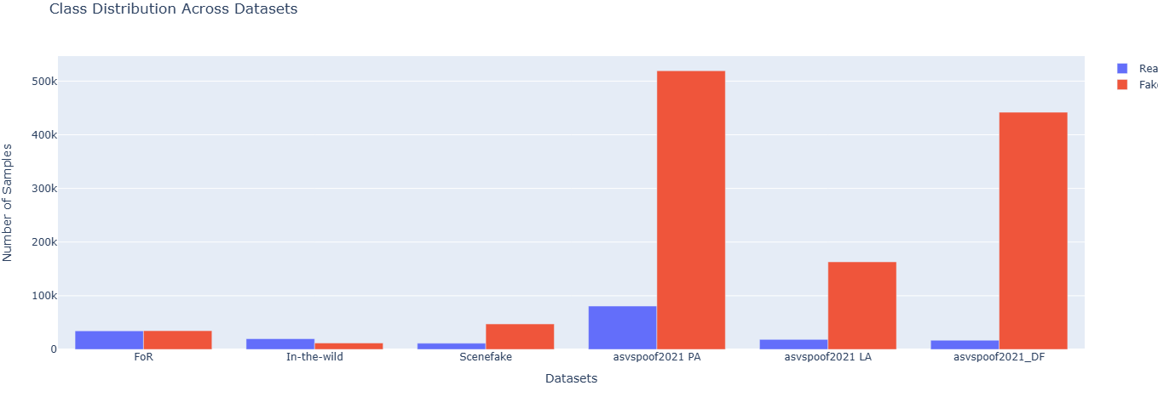
Methodology with implementation and evaluation
Initial Model Development:
Audio Detector
Data Collection:
The Fake-or-Real (FoR) dataset was utilized for the initial phase of this project.
The dataset contains over 195,000 utterances, including both human and computer-generated speech.

Slide 14
Methodology with implementation and evaluation
Initial Model Development:
Audio Detector
Feature Engineering:
In the feature engineering step, four key audio features were extracted from the dataset:
Mel-Spectrogram: Represents the power spectrum of sound frequencies over time, providing a visual representation of audio signals.
MFCC (Mel-Frequency Cepstral Coefficients): Captures the short-term power spectrum of sound, widely used in speech and audio processing.
CQT (Constant-Q Transform): Provides a frequency representation of the audio signal, emphasizing the musical properties.
Chroma: Represents the twelve different pitch classes, useful in music and audio analysis.

Slide 15
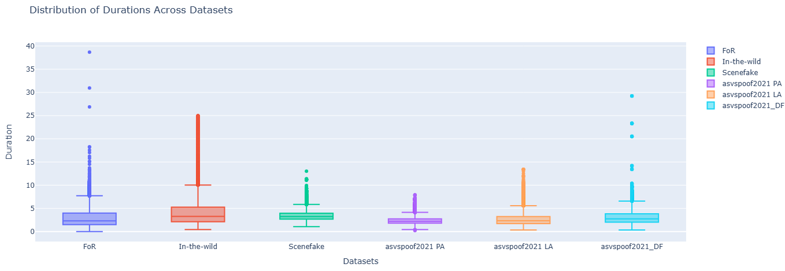
Methodology with implementation and evaluation
Initial Model Development:
Audio Detector
These features were then represented as images to serve as input for the convolutional neural network (CNN).

Slide 16

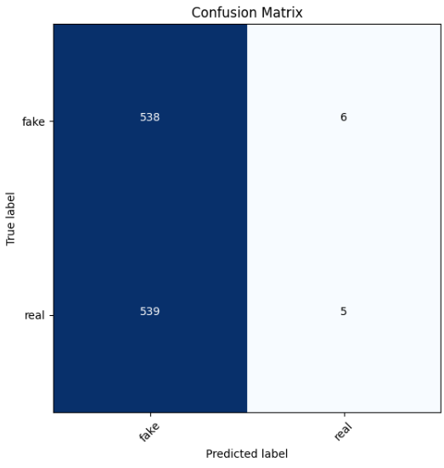
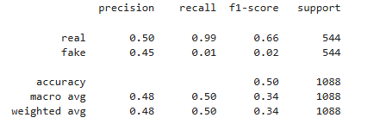
Methodology with implementation and evaluation
Initial Model Development:
Audio Detector
Model Architecture:
A custom CNN model with 4 hidden layers was designed for this stage. The CNN was chosen for its ability to effectively process and extract features from image representations of audio signals.
Utilizing Pre-trained Models:

Slide 17
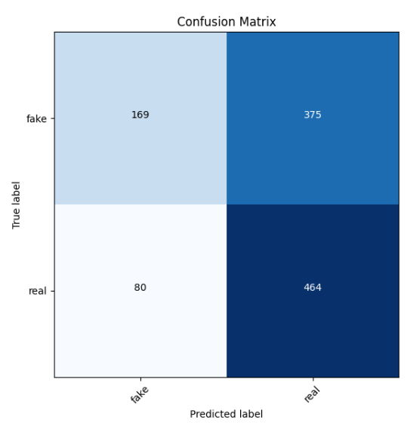
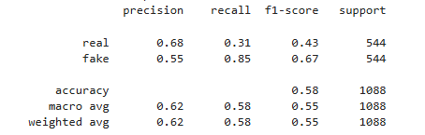
Initial Model Development:
Methodology with implementation and evaluation
Utilizing Pre-trained Models:
Audio Detector
Data Collection and Feature Engineering:
The same FoR dataset and feature extraction techniques were used in this stage to maintain consistency and ensure comparability of results.
Model Architecture :
VGG-16: A deep convolutional network known for its performance in image classification tasks.

Slide 18

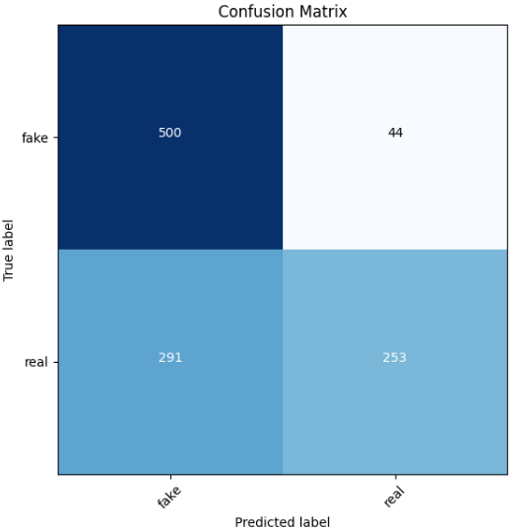
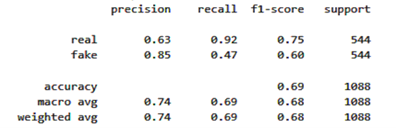
Methodology with implementation and evaluation
Utilizing Pre-trained Models:
Audio Detector
First Phase
Model Architecture :
MobileNet: A lightweight and efficient model designed for mobile and embedded vision applications.
Advanced Techniques:

Slide 19
Utilizing Pre-trained Models:
Methodology with implementation and evaluation
Advanced Techniques:
Audio Detector
First Phase
Second Phase
Data Collection :
To enhance the model’s generalization capability, four additional datasets were incorporated:
SceneFake: Contains various synthetic and real audio samples.
In The Wild: Includes real-world audio data, providing a diverse range of speech samples.
ASVspoof 2019: Focuses on spoofing attacks, providing data for both logical and physical access scenarios.
ASVspoof 2021: An updated dataset with more challenging spoofing scenarios.
Model Architecture :
The Wav2Vec2.0 model was chosen for its state-of-the-art performance in speech recognition tasks. This model uses a large amount of unlabeled data to learn high-quality speech representations.

Slide 20
Utilizing Pre-trained Models:
First Phase
Methodology with implementation and evaluation
Advanced Techniques:
Audio Detector
Second Phase
Third Phase
Training:
The model was trained on a combination of three datasets (FoR, SceneFake, and In The Wild) simultaneously to further improve generalization.
Results:
Training Accuracy: 99%
Validation Accuracy: 99%
Testing Accuracy: 99%
Although the combined training resulted in high accuracy, the model exhibited poor generalization when tested on entirely new and unseen data, indicating overfitting to the combined dataset.

Slide 21
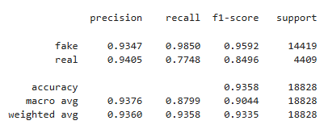
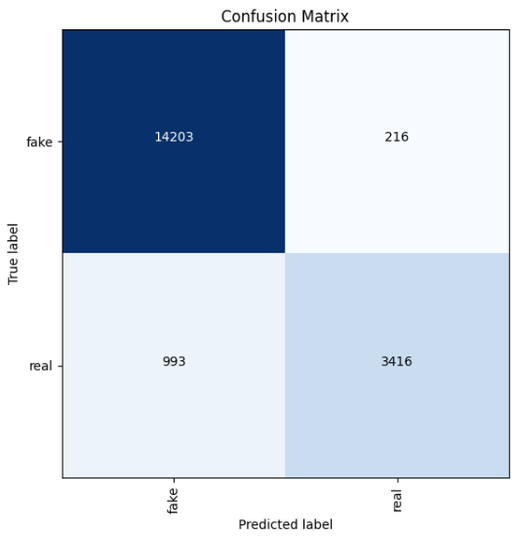
Second Phase
Methodology with implementation and evaluation
Advanced Techniques:
Audio Detector
Third Phase
Training:
To address the overfitting issue, the model was trained on the Logical Access (LA) and Physical Access (PA) data from the ASVspoof 2021 dataset, focusing on different types of spoofing attacks.
Results :
ASVspoof 2021 DF Testing

Slide 22
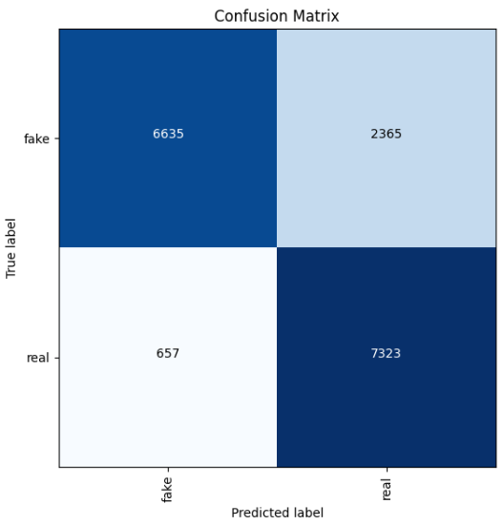
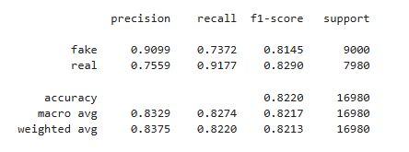
Second Phase
Methodology with implementation and evaluation
Advanced Techniques:
Audio Detector
Third Phase
Results :
ASVspoof 2019 DF Testing

Slide 23
Second Phase
Methodology with implementation and evaluation
Advanced Techniques:
Audio Detector
Third Phase
Metrics | Custom CNN | MobileNet | VGG16 | Wav2Vec2.0
Precision | 0.48 | 0.74 | 0.62 | 0.93
Recall | 0.50 | 0.69 | 0.58 | 0.93
F1-Score | 0.34 | 0.68 | 0.55 | 0.90
Accuracy | 0.50 | 0.69 | 0.58 | 0.93

Slide 24
Models Selection
Methodology with implementation and evaluation
Audio Model
Text Model
Image Model

Slide 25
Methodology with implementation and evaluation
Existing Techniques In Text Detection Techniques:
Stylometry:
Method: Analyses text for stylistic features such as syntax and grammar.
Tools: Linguistic models, frequency analysis.
Strengths:
Captures subtle stylistic differences.
Proven technique for authorship attribution.
Limitations:
Struggles against AI mimicking human styles.
May misclassify atypical legitimate text styles

Slide 26
Methodology with implementation and evaluation
Existing Techniques In Text Detection Techniques:
Contextual Analysis:
Method: Examines text coherence, context, and relevance.
Tools: NLP algorithms, context-aware models.
Strengths:
Effective in identifying logical inconsistencies.
Broadly applicable to different text types.
Limitations:
Subjective nature can lead to false positives.
Computationally intensive for complex contexts.

Slide 27
Methodology with implementation and evaluation
Existing Techniques In Text Detection Techniques:
Machine Learning Classifiers:
Method: Uses models trained to distinguish human and AI-generated text.
Tools: SVMs, Transformer models.
Strengths:
Capable of real-time analysis.
Learns and adapts with more data.
Limitations:
Can produce false positives/negatives.
Resource-intensive training and operation.
Gap in scientific scene.
Methodology with implementation and evaluation.
Discussion.
Conclusion.

Slide 28
Methodology with implementation and evaluation
2.Text Detector :
Our journey to reach the final result was divided into 3 steps:
Build Model from scratch.
Go to Pre-train Models (Mistral 7B & BERT).
Final model (RoBERTa & DeBERTa).
Build Model from scratch

Slide 29
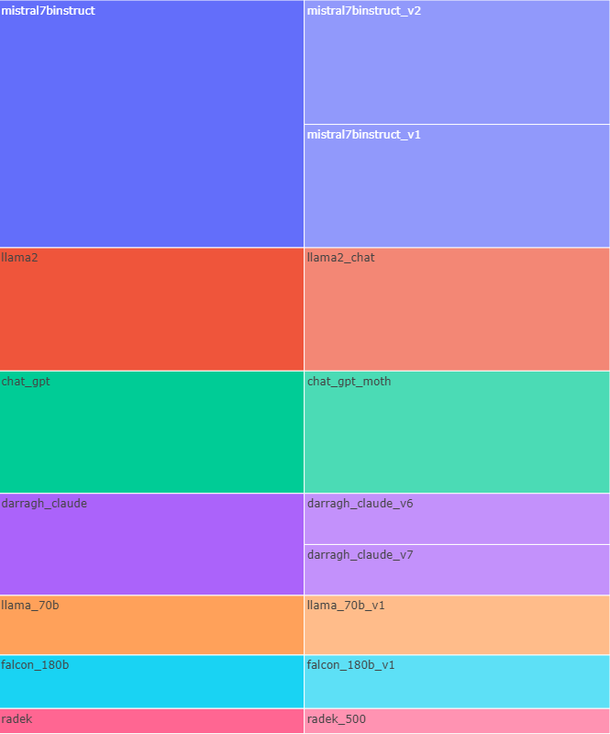
Methodology with implementation and evaluation
Build Model from scratch
Text Detector
Data acquisition:
Data was collected from HuggingFace and Kaggle :
LLM - Detect AI Generated Text.(1378)
DAIGT | All data For Model:
We created Dataset to combine all the different data that we found on Kaggle and Huggingface to make it easier for us to use it and apply preprocessing to it , to reach about 273,715 thousand and to make balance data we use 263,718 .

Slide 30
Methodology with implementation and evaluation
Build Model from scratch
Text Detector
Data preprocessing:
Removed unwanted characters like carriage returns and URLs, cleans up hashtags and special characters, reduces multiple spaces to a single space, and converts text to lowercase if needed.
Tokenization:
Use tokenizer from Keras and ELMo to Embedding .
Use pre-trained BERT Tokenizer and Embedding from Transformer library.
Length sequence 512.

Slide 31
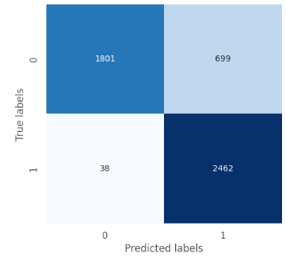
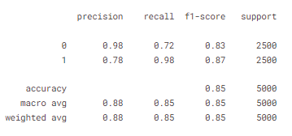
Methodology with implementation and evaluation
Build Model from scratch
Text Detector
Model Architecture :
Use Bi-LSTM to allows the model to capture context and understand sentence from both directions.
use convolutional layer that operates on sequential data with one spatial dimension to increase complexity.
Go to Pre-train Models :

Slide 32
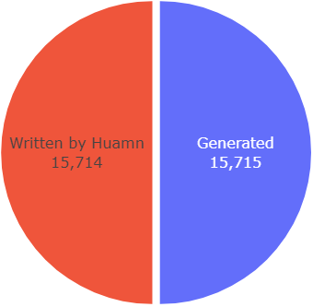
Build Model from scratch
Methodology with implementation and evaluation
Go to Pre-train Models :
Text Detector
Data Preparation:
We only used the data collected from Kaggle, which was about 32,462 data.
We used the data as it is, without cleaning , because we believe that these symbols are considered a feature for text detection.
Model Architecture:
Mistral 7B is a robust and efficient model for classification tasks, offering a compelling combination of performance, adaptability, and cost-effectiveness. Its ability to handle complex text understanding .

Slide 33
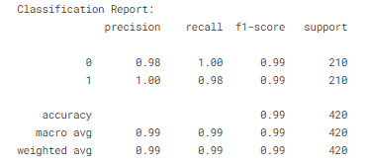
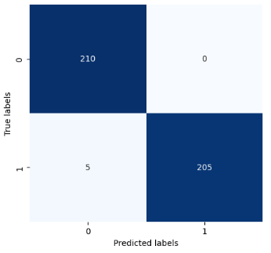
Methodology with implementation and evaluation
Go to Pre-train Models :
Text Detector
Challenges:
Model Size:
Memory Consumption.
Storage Requirements
Computational Time:
Training Time.
Inference Time.

Slide 34
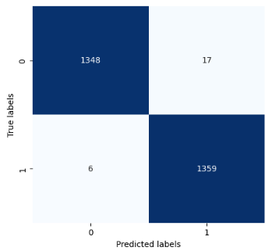
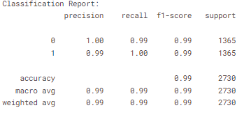
Methodology with implementation and evaluation
Go to Pre-train Models :
Text Detector
Model Architecture:
BERT is specialized for tasks requiring deep contextual understanding and has set benchmarks in many NLP tasks due to its bidirectional approach.
Size: Original BERT comes in different sizes, such as BERT-Base (110 million parameters)
Final model:

Slide 35

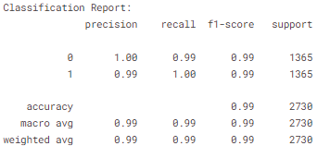
Go to Pre-train Models :
Methodology with implementation and evaluation
Final model:
Text Detector
Model Architecture:
RoBERTa Enhanced version of BERT with optimizations in training methods and datasets, removing the next sentence prediction task.
Achieves improved performance across various NLP benchmarks due to longer training, dynamic masking, and more comprehensive pretraining data.

Slide 36

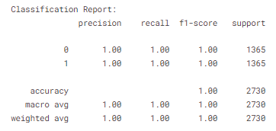
Methodology with implementation and evaluation
Final model:
Text Detector
Model Architecture:
DeBERTa Advanced model with architectural enhancements like disentangled attention and an enhanced mask decoder.
Excels in capturing the relationship between words and their positions for more accurate context understanding.

Slide 37
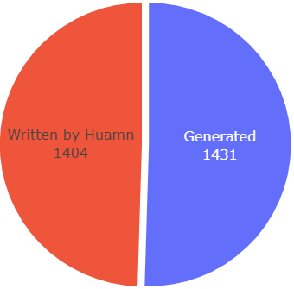
Methodology with implementation and evaluation
Final model:
Text Detector
Ensemble of RoBERTa and DeBERTa:
Averaging Probabilities: This method focused on the individual model outputs – the probabilities assigned to each text being human-written or LLM-generated. We calculated the ensemble prediction by averaging the corresponding probabilities from DeBERTa and RoBERTa for each category.
Feed-forward Model: We constructed a new feed-forward neural network (32 neurons) specifically for this task. This model took the individual model probabilities from DeBERTa and RoBERTa (human-written and LLM-generated) as input features alongside the actual ground truth labels (human-written or LLM-generated) as the target variable.
Some data is collected by us and Kaggle for use in human-evaluation

Slide 38
Methodology with implementation and evaluation
Final model:
Text Detector
Model | Accuracy | Precision | Recall | F1-score | ROC-AUC
BERT | 0.994356 | 0.990978 | 0.997904 | 0.994429 | 0.994322
RoBERTa | 0.995767 | 0.998406 | 0.997904 | 0.995816 | 0.995747
DistilBERT | 0.992240 | 0.995081 | 0.989518 | 0.992292 | 0.992266
DeBERTa | 0.998942 | 0.997908 | 1.000000 | 0.998953 | 0.998932
Averaging Probabilities (RoBERTa -DeBERTa) | 0.983069 | 0.998558 | 0.967855 | 0.982967 | 0.983215
Feed-forward Model (RoBERTa -DeBERTa) | 0.999647 | 0.999302 | 1.000000 | 0.999651 | 0.999644

Slide 39
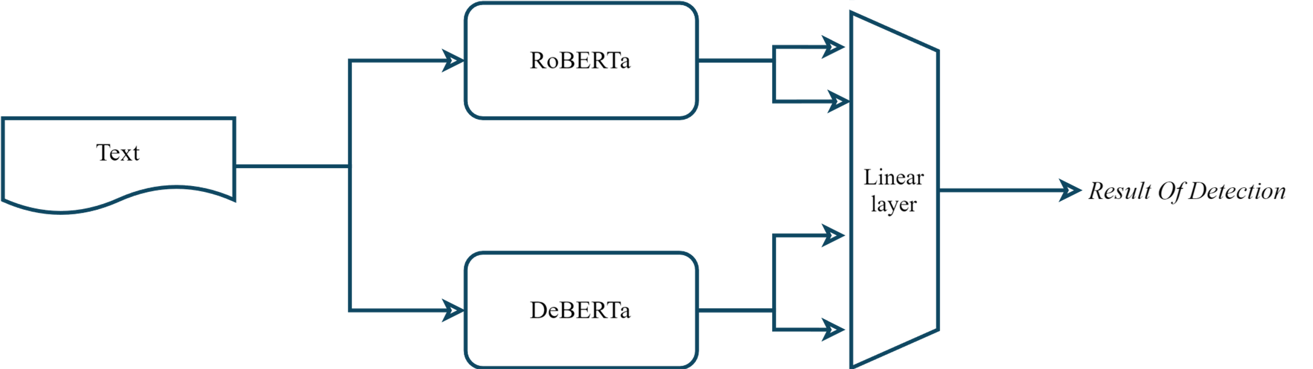
Methodology with implementation and evaluation
Final model:
Text Detector

Slide 40
Models Selection
Methodology with implementation and evaluation
Audio Model
Text Model
Image Model

Slide 41
Methodology with implementation and evaluation
Existing Techniques In Image Detection Techniques:
Forensic Analysis :
Method: Looks for inconsistencies in lighting, shadows, and reflections
Tools: Error Level Analysis (ELA), chromatic aberration analysis.
Strengths:
Effective at detecting visual inconsistencies.
Widely applicable to various manipulations.
Limitations:
Advanced techniques may bypass detection.
Requires expert interpretation for subtle anomalies.
Gap in scientific scene.
Methodology with implementation and evaluation.
Discussion.
Conclusion.

Slide 42
Methodology with implementation and evaluation
Existing Techniques In Image Detection Techniques:
GAN Fingerprints:
Method: Analyses patterns left by GANs.
Tools: Feature extraction algorithms, GAN-specific detection models.
Strengths:
Recognizes unique GAN patterns.
Effective for detecting GAN-generated images.
Limitations:
Newer GANs may hide these patterns.
Not applicable to non-GAN images.
Gap in scientific scene.
Methodology with implementation and evaluation.
Discussion.
Conclusion.

Slide 43
Methodology with implementation and evaluation
Existing Techniques In Image Detection Techniques:
Deep Learning Models:
Method: Trains models to distinguish real from AI-generated images.
Tools: CNNs, ResNet, EfficientNet.
Strengths:
Scalable for large-scale analysis.
Adaptive and improves with data.
Limitations:
Requires diverse training data.
Vulnerable to adversarial attacks.

Slide 44
Methodology with implementation and evaluation
3.Image Model :
Our journey to reach the final result was divided into 3 Stages:
Build Model from scratch using CNN.
Data Augmentation.
Use Pre-trained Models .

Slide 45
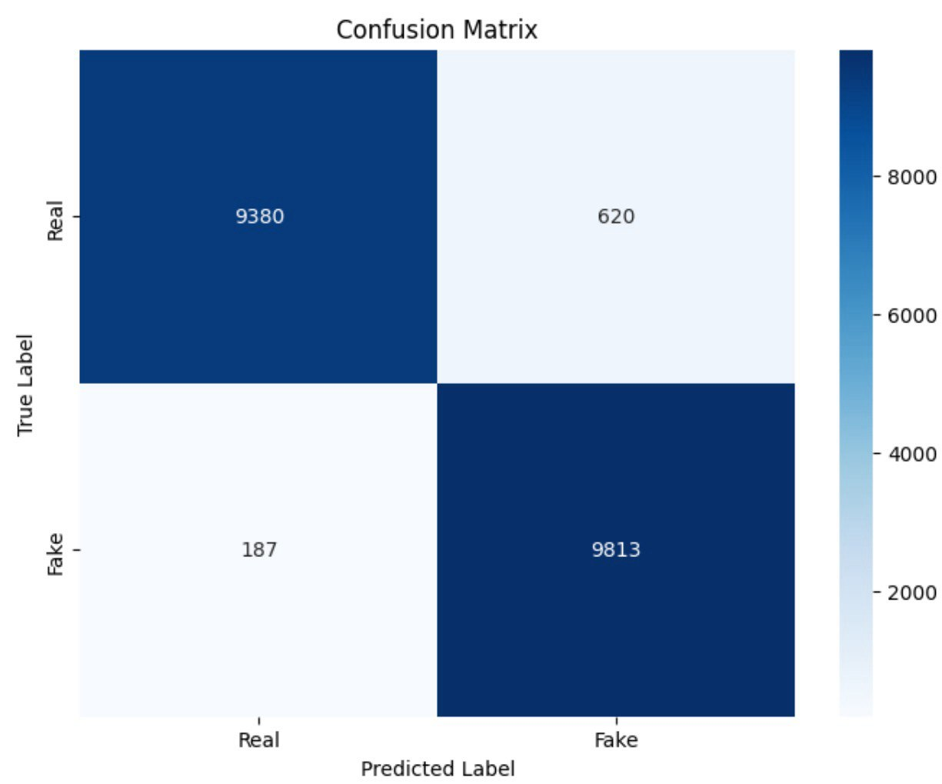
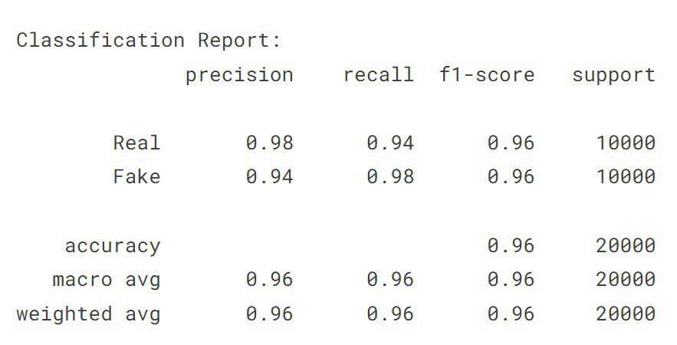
Methodology with implementation and evaluation
Build Model:
Image Detector
Data acquisition:
The Data was 140 thousand images, split evenly having fake images from StyleGAN 1 created by nvidia, and flickr images collected by nvidia to train its GAN models.
Model Architecture:
model using 5 CNN [32,64,128,128] Layers and 1 Feed forward layer [128 ]
Data Augmentation:

Slide 46
Build Model:
Methodology with implementation and evaluation
Data Augmentation:
Image Detector
It had generalization problems because it was trained on 1 model only this takes us to stage 2.
The data have various image size ranging between 512 – 1024 to allow the testing of different models.
200K images
Train |  | Validate |  | Test
Real: 70 k | Fake: 70 k | Real: 15 k | Fake: 15 k | Real: 15 k | Fake: 15 k
70k Flickr | 3k SD V2.1 | 15 k CelebA HQ | 3k SDXL 1.0 | 15 k CelebA HQ | 2536 SD 1.4
 | 3k SD V1.5 |  | 3k SG1 |  | 3116 SG1
 | 16k SG1 |  | 3k EG3D |  | 3116 EG3D
 | 16k EG3d |  | 16k S SG2 |  | 3116 S SG2
 | 16k S SG2 |  | 16k S SD1.4 |  | 3116 S SD1.4
 | 16k S SD1.4
70 % Data |  | 15 % Data |  | 15 % Data

Slide 47
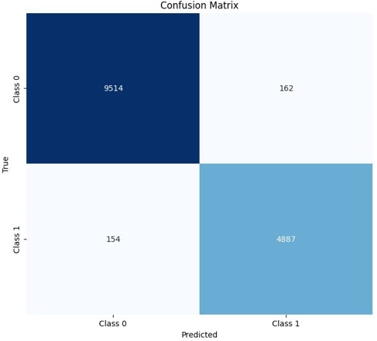
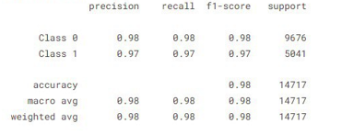
Build Model:
Methodology with implementation and evaluation
Data Augmentation:
Image Detector
These data were used on the same model architecture :
Use Pre-trained Models:

Slide 48
Data Augmentation:
Methodology with implementation and evaluation
Use Pre-trained Models:
Image Detector
To achieve robustness and generalization we decided to use state of the art pre trained models and vision transformers.
Models Architecture:
Xception : we choose this model due to its efficient calculations using the depth wise operations to reduce number of parameters, and number of operations
Efficient Net: Allows versatility as it dynamically Scales its own network width, depth, and resolution, the difference between versions is in the resolution. B2: 260 B6: 528
ViT: the first vision transformer to appear, its attention mechanism allows for robust detection of small details.

Slide 49
Methodology with implementation and evaluation
Use Pre-trained Models:
Image Detector
Pre-trained Models
Metrics | EfficientNetB2 | EfficientNetB6 | ViT 224 | ViT 384 | Xception
Accuracy | 94.3% | 99.5% | 96.7% | 98.8% | 97%
Precision | 94.3% | 99.5% | 96.7% | 98.8% | 98%
Recall | 94.2% | 99.5% | 96.6% | 98.8% | 97%
F1-Score | 94.2% | 99.5% | 96.6% | 98.8% | 98%

Slide 50

System Architecture
Methodology with implementation and evaluation
Overview of System.
Model or Pattern.
Client (Frontend).
Server (Backend).

Slide 51
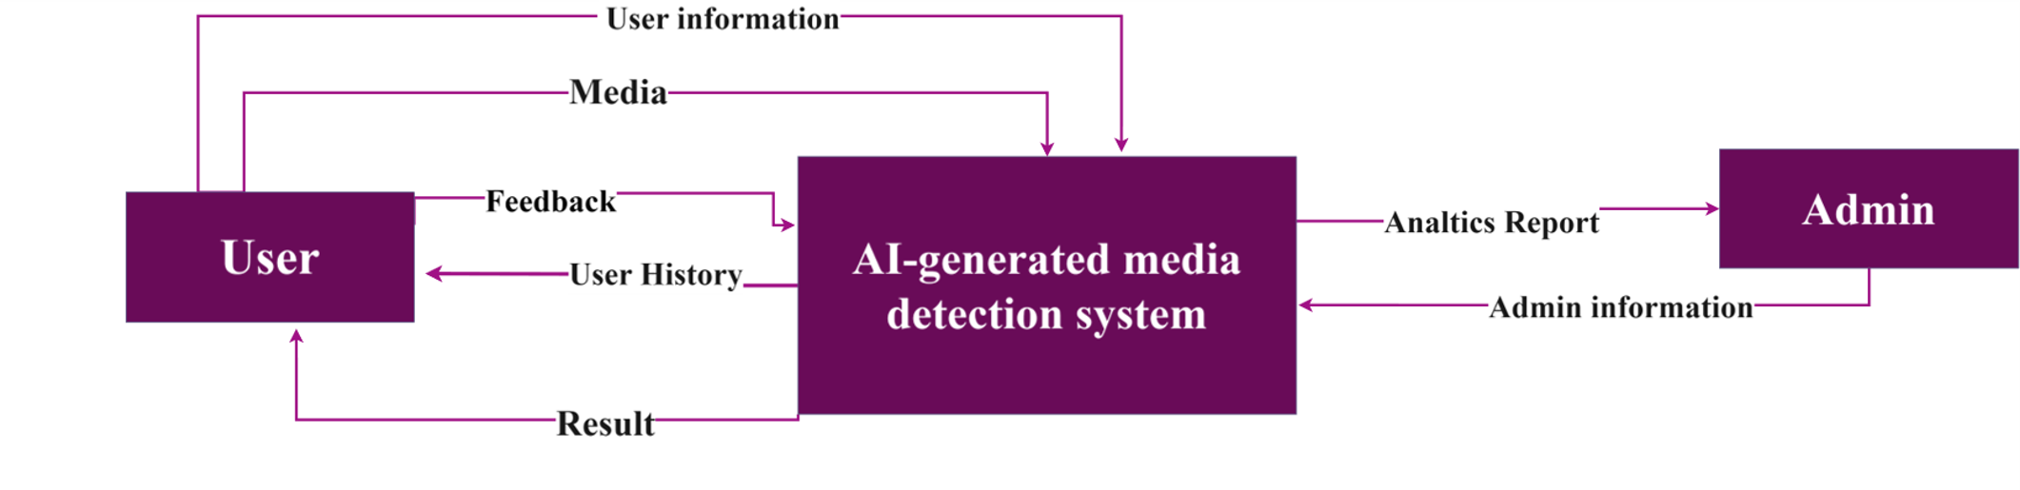
Methodology with implementation and evaluation
System Architecture:
Overview of System
The AI-Generated Media Detection project adopts a modular architecture, separating frontend and backend components to ensure scalability, maintainability, and flexibility.
This architecture facilitates independent development and deployment of each layer while promoting efficient communication through RESTful APIs.

Slide 52
Methodology with implementation and evaluation
System Architecture:
Model or Pattern:
Client-Server Architecture with RESTful APIs.
Client (Frontend):
Responsibilities : Handles presentation logic and user interaction.
Communication :Communicates with the backend server via HTTP requests using RESTful APIs to fetch data, submit user actions (e.g., authentication, media detection requests), and display results.
Server (Backend):
Responsibilities: Implements business logic, manages data persistence, and integrates with external services.
APIs: Exposes RESTful APIs that the frontend consumes, handling requests for user authentication, media detection, user profile management, and other application functionalities.
Security: Implements JWT tokens for secure authentication and authorization, ensuring data integrity and privacy.
Conclusion.
Discussion.

Slide 53
Methodology with implementation and evaluation
Discussion.
Conclusion.

Slide 54
Methodology with implementation and evaluation
Conclusion.
System built on the website that supports multimedia.
Gap in scientific scene.
Multimodal detection.
Generalized models.
Real-time Detection.
Explainability.

